Slide 1
Team Members: Raja Kumaran & sai eshwar
Ideathon conducted by EMIDS

Slide 2

Problem Statement
Problem: Currently healthcare service providers- hospitals/clinics operate in silos, there is no unified platform for storing patient records and sharing them with out-of-network hospitals/clinics.
Solution: To have user friendly hybrid (Web & Mobile) application to enable connectivity and accessibility for both user and health care service providers
Notes:
Action:
1.Hybrid application to manage customer record, organize and manage.
2. Monitor and prevent diseases and infection that can be prevented and reduce the chances of
Infectious diseases
Coronary heart disease
Type 2 diabetes
Preventable diseases:
Infectious diseases: Keep up to date with childhood and adult vaccinations with the help of your doctor. Have your doctor monitor your vaccination schedule and follow their advice for special vaccinations, especially those that don't give lifelong immunity.
Coronary heart disease: To reduce your risk of a heart attack stay active, eat a healthy diet, and maintain a healthy weight. If you’re a smoker, quitting will also lower your risk. Regularly monitor your blood pressure and cholesterol levels and familiarise yourself with the symptoms of heart disease.
Type 2 diabetes: A combination of regular physical activity, healthy eating and weight reduction can prevent or slow the onset of type 2 diabetes.

Slide 3
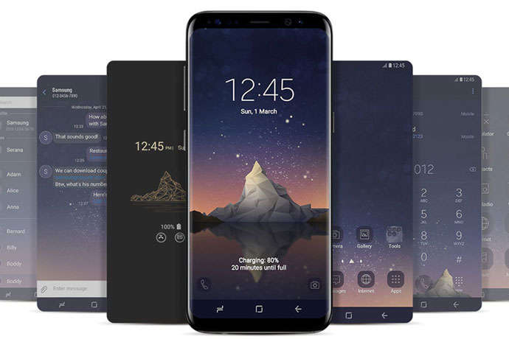
Mobile App Development
Statistics show that there are currently over 325, 000 health-related mobile health apps now presented on app marketplaces.
60% of mobile device users downloaded a mHealth app to their device (39% of downloads), while iOS users prefer using health-oriented medical apps (62% of downloads).
Notes:
290million mobile user.
37- Android 61-Ios.
mobile health care apps improved productivity.

Slide 4
App Features
Secured data access
Export Data options
Managing appointments
Scan & Attach documents
Charts & Insights
Lifetime Family Backup Data

Slide 5
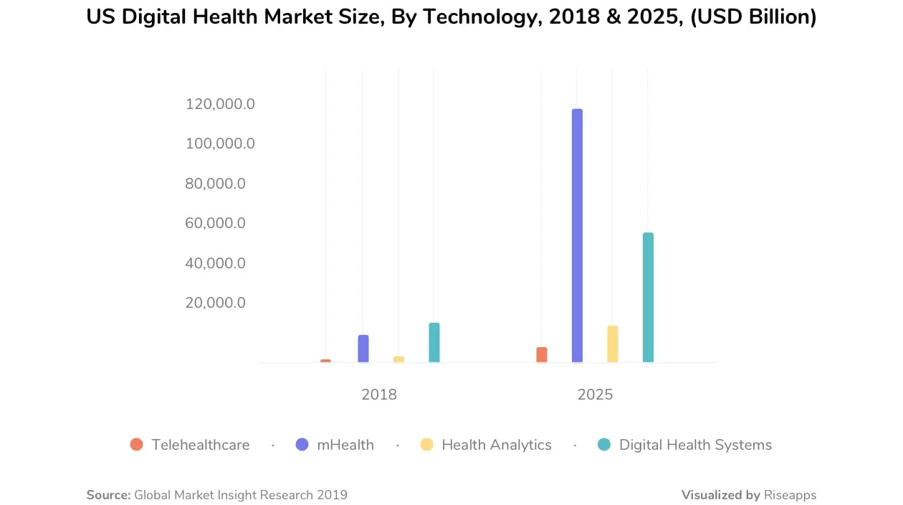
Market ANALYSIS

Slide 6
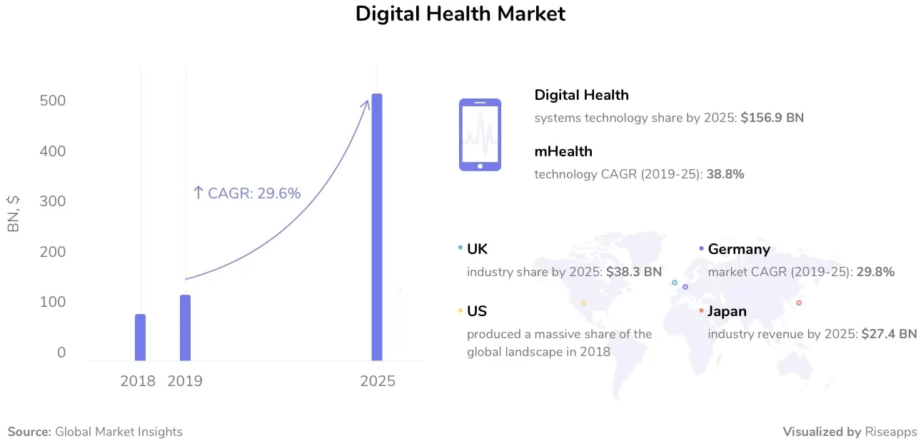
Market ANALYSIS
The global health market is worth almost $10 trillion in both private and governmental sectors. In 2018 the USA digital health market was valued at USD 86.4 billion as reported by Global Digital Market research. According to various estimations, the global market size is to increase, exceeding $118 billion in 2021 to more than $504 billion in 2025 due to the adoption of advanced technologies.
Notes:
26.9% average rise across years

Slide 7
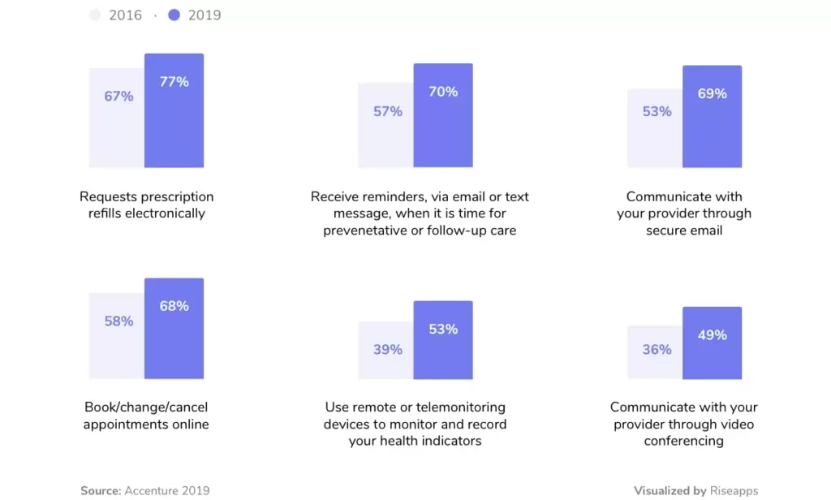
Market ANALYSIS
Patients are expecting digital capabilities from medical providers. Younger generations, often referred to as Generation Z and Millennials, are more likely to choose a digital provider who offers digital services.

Slide 8
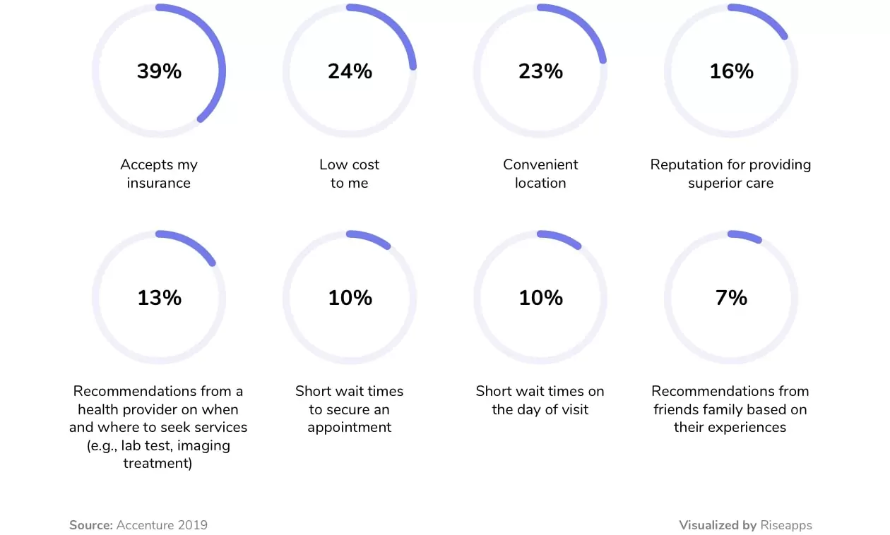
Market ANALYSIS
According to the Accenture 2019 Digital Consumer survey, convenience becomes the top factor when seeking medical treatment. People are also paying attention to the affordability and reputation of a medical provider.

Slide 9
Input & Output Model Concept
Initial Data Exploration
Noise Elimination Inferencing
Dependent Variables
Medical history
Dependent Variables
Specializations (Radiology, Pathology)
Insurance
Health Prediction
Risk Severity
Machine Learning
& Text Analytics Model
Vaccine & Medication details
Allergy
BP, Blood Glucose Other Attributes
Lab reports
Preprocessing Standardization Feature
Importance
Prescription
Medical history
Upcoming Appointment

Slide 10
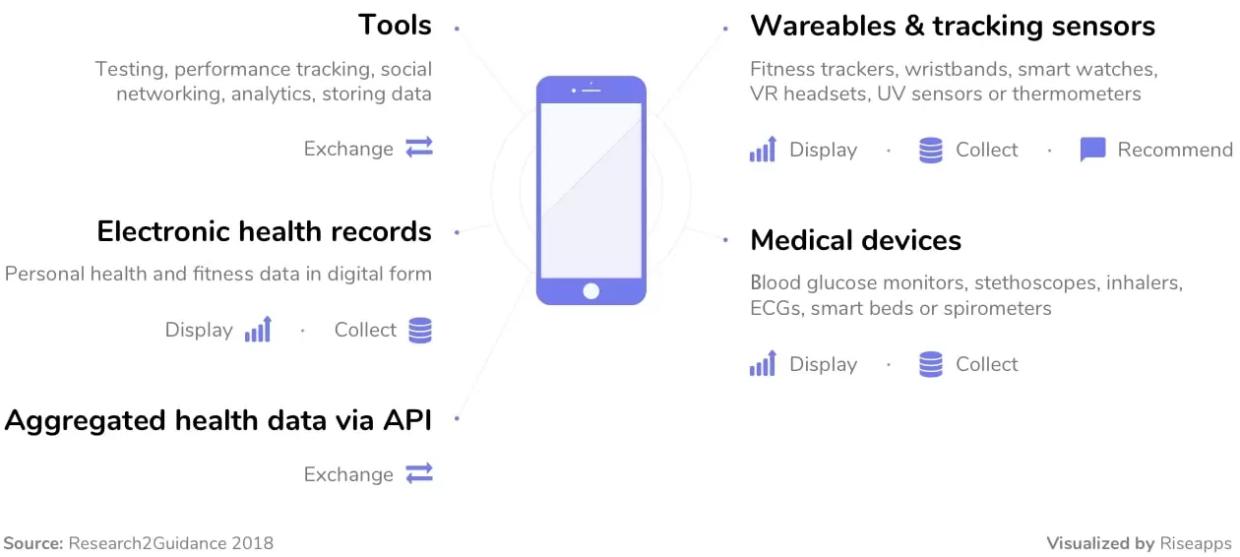
Deliverables
1. Contents Here A
Growth
You can simply impress your audience and add a unique zing and appeal to your Presentations. Easy to change colors, photos and Text.
2. Contents Here B
Features
You can simply impress your audience and add a unique zing and appeal to your Presentations. Easy to change colors, photos and Text.
3. Contents Here C
Reliability
You can simply impress your audience and add a unique zing and appeal to your Presentations. Easy to change colors, photos and Text.
4. Contents Here D
Expansion
You can simply impress your audience and add a unique zing and appeal to your Presentations. Easy to change colors, photos and Text.

Slide 11
Conclusion
Easy Access to Functionalities
Detailed, Actionable Information
Easy Communication with Professionals
Patient Community
Simple Yet Amazing Digital Experience
REFERENCE:
https://theappsolutions.com/blog/development/healthcare-mobile-apps/
https://imaginovation.net/blog/developing-a-mobile-health-app-what-patients-really-want/

